Slide 1
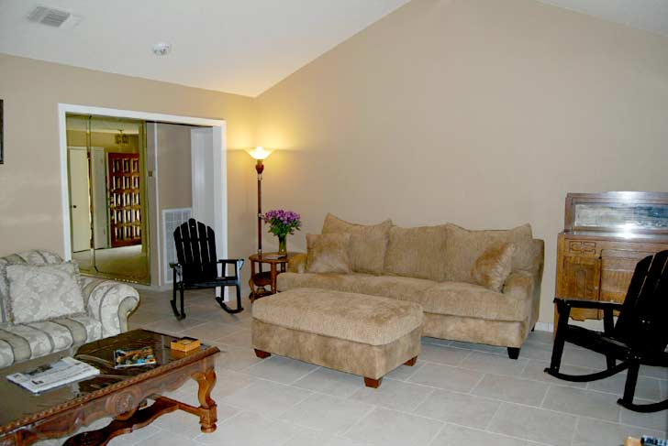
Hillyard Power Module
Resident Room Cleaning
Living Quarters
© Hillyard, Inc.
Notes:
Hillyard Power Module: Resident Room Cleaning

Slide 2
Trash Containers
Empty trash containers
Spray interior
Reline
Spot clean exterior
!
If the liner leaked, rinse the inside of the container and let air-dry before relining
Dry trash? Empty container.
Soiled Liner? Change it.
Spray the inside.
Reline.
Clean outside.
Notes:
Empty trash containers. If there is only paper in the trash can it may be emptied. If there are liquids, food or other items that have soiled the liner, change it. If the liner leaked, rinse the inside of the trash can and allow it to air-dry before relining. Wipe down the exterior of the trash can with disinfectant cleaner to remove spots and stray marks.

Slide 3
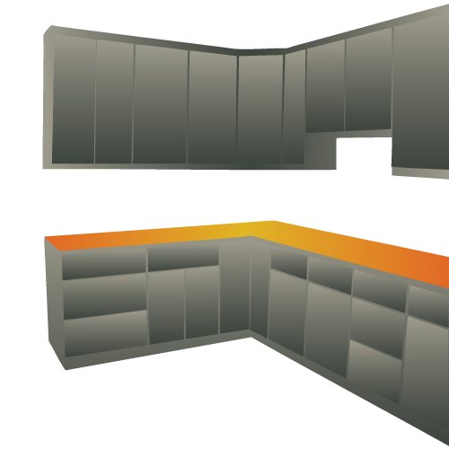
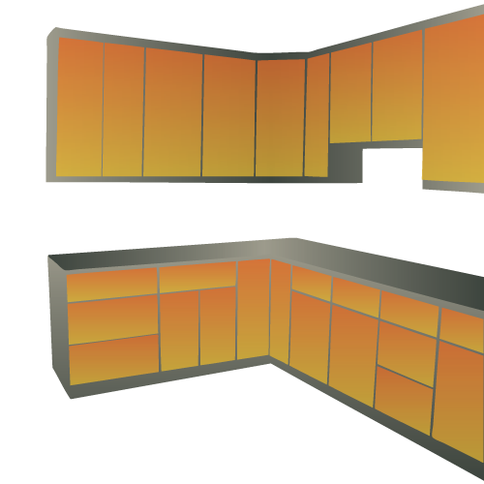
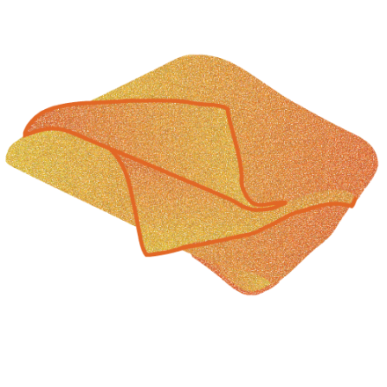
Dust
Using dusting cloth
and extension duster
Work top-down; prevent re-soiling
Use extension tools on high and low surfaces to minimize stretching and bending
Use dusting cloths on mid-level surfaces
Minimize strain on your body.
Notes:
Always work from the top of the room downward to prevent re-soiling of previously cleaned surfaces.
Use an extension duster to reach high and low surfaces. Use a dusting cloth or mitt on mid-level surfaces. This will save strain on your body from bending low or stretching high.

Slide 4
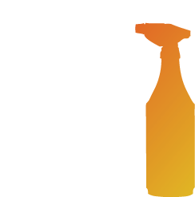
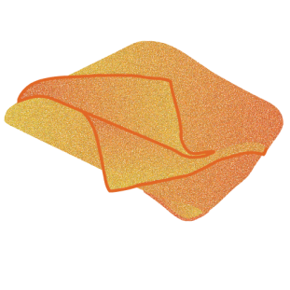
Disinfect Sink and Mirror
Apply disinfectant cleaner
to all sinks and mirrors.
Allow to remain wet on the surface of sinks
for 10 minutes.
Clean mirrors (including frames)
with paper towels or squeegee.
Wipe sinks to clean. Dry with a clean, soft cloth and polish chrome as applicable.
50% Faster
!
Option:
Spray and wipe all surfaces to clean.
Re-spray and allow to air dry.
Notes:
Apply disinfectant cleaner to all surfaces of the sinks (inside, outside, top, bottom, handles, spout, and any exposed plumbing underneath. Apply to the walls immediately surrounding the sink and to all dispensers. Allow to stand wet on the surface for ten minutes. Re-spray surfaces as necessary to have enough liquid to clean. Wipe surfaces with a clean soft cloth to remove soils, and leave surfaces streak-free.
Clean mirror (including frame) with paper towels or a squeegee.
Optionally, spray all surfaces with disinfectant cleaner and immediately wipe to clean, removing all streaks. After cleaning, re-spray the surfaces with disinfectant cleaner and allow to air dry to provide the required ten minute dwell time.
Another option is to wring a cloth in a utility pail filled with disinfectant cleaner and fold it to make an 8-sided cleaning cloth. Wipe the surfaces to clean, turn the cloth to a clean side and wipe again. Allow surfaces to air dry.

Slide 5
Disinfect Toilet
Option 1
Apply disinfectant cleaner with a trigger sprayer.
Interior and
exterior surfaces.
Allow 10 minutes
dwell time.
Re-spray as necessary
and wipe to clean.
Notes:
Option 1: Apply disinfectant cleaner to the toilet(s) using a trigger sprayer to spray the inside surfaces and to spray a bowl brush or bowl swab sufficiently to apply the disinfectant cleaner up under the flush ring.
Spray all outside surfaces of the toilet, including undersides and other hidden areas.
Allow disinfectant to stand wet on the surfaces for 10 minutes to achieve 100% germ kill. After ten minutes have passed, reapply disinfectant cleaner as necessary to have enough liquid to clean, and scrub the interior with a bowl brush or swab. Flush several times to rinse.
Re-spray the outside surfaces as necessary and wipe to clean. If necessary, wipe the outside surfaces a second time with a clean, dry, soft cloth to remove streaks and to shine chrome.

Slide 6
Disinfect Toilet
Option 2
Wring a cloth in a utility pail of disinfectant cleaner
Apply disinfectant cleaner to the interior with a bowl brush or swab
Scrub interior surfaces with a bowl swab or brush and flush to rinse.
Wipe exterior surfaces and allow to air dry.
Notes:
Option 2: Apply disinfectant cleaner to interior surfaces using a bowl brush or bowl swab and a container dedicated to cleaning the inside of toilets and urinals only.
Wring a cloth in a utility pail of disinfectant cleaner, fold it to make an 8-sided cleaning cloth, and wipe the outside surfaces to clean. Turn the cloth to a clean side frequently and wipe the surfaces a second time. Allow surfaces to air dry.

Slide 7
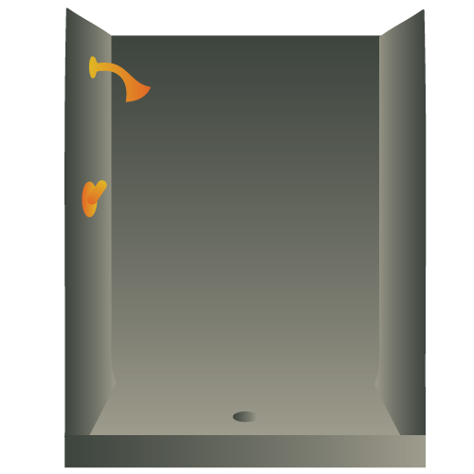
Tub and Shower
Disinfect
!
Optionally:
Spray, wipe,
re-spray, and allow to air dry.
Spray disinfectant cleaner on all surfaces of the tub and shower.
Wipe surfaces until clean and streak free.
Wipe all surfaces of the tub and shower.
Turn the cloth to a clean side, re-wipe
and allow to air-dry.
Notes:
Spray disinfectant cleaner on all surfaces of the tub and shower. Allow to stand wet for 10 minutes. Wipe all surfaces until clean and streak free. Re-spray surfaces as necessary to have enough liquid to clean.
Optionally, spray the surfaces of the tub and shower and immediately wipe until clean and streak free. Once all surfaces have been cleaned, re-spray with disinfectant cleaner and allow to air dry.
Another option is to wring a cleaning cloth in a utility pail filled with disinfectant cleaner. Fold it into an 8-sided cloth and begin wiping all surfaces of the tub and shower.
After wiping a surface clean, turn the cloth over to a clean side and wipe it again to apply enough disinfectant cleaner to stand wet on the surfaces as they air-dry.

Slide 8
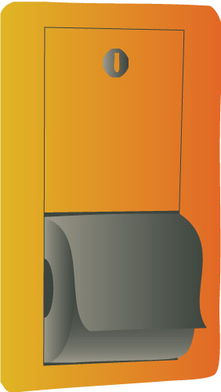
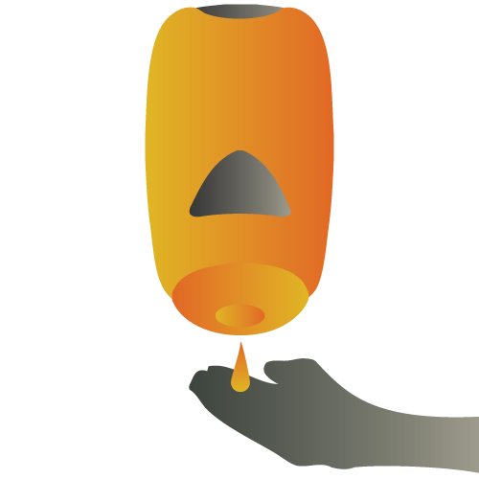
Dispensers
Check and refill
Disinfect
Spray and wipe outside of dispensers.
Dispensers were checked when disinfectant cleaner was applied earlier; those needing to be refilled were left open as a reminder.
Fill them now.
Notes:
Check and refill dispensers as necessary. Spray and wipe the outside of dispensers with disinfectant cleaner.

Slide 9
Spot Clean Glass
Most spots, fingerprints, and other smudges occur from 4 to 6 feet off the floor
Remove these obvious spots daily; lightly spray glass cleaner on spots, wipe to clean and dry streak-free
Clean the entire piece of glass if necessary
Windows, door glass, display case glass, any other glass surfaces
Notes:
Spot clean glass, including entry windows, door glass, display case glass, glass tabletops and any other glass in the room. Lightly spray glass cleaner on fingerprints and smudges. Wipe to remove the spot and to dry the surface streak-free

Slide 10
Make Bed
Use existing linen unless soiled
or otherwise directed.
Notes:
Make the bed using existing linen unless soiled or otherwise directed.

Slide 11
Dresser and Nightstand
Wipe surfaces with disinfectant cleaner.
Apply surface treatment (furniture polish)
as applicable.
Notes:
Wring a cleaning cloth in a utility pail of disinfectant cleaner. Fold to make an 8-sided cloth and wipe the top, sides, front, and any open shelves of the dresser(s) and night stand(s) turning the cloth as necessary. Apply surface treatments if applicable.

Slide 12
Spot Clean
Chairs and tables
Vertical and horizontal surfaces
!
Optionally,
Use a utility pail
and cloth.
Spray visible soils.
Wipe to clean leaving no streaks or residue.
Notes:
Spot clean chairs, tables, and vertical and horizontal surfaces. Spray visible soils on non-upholstered chairs, on tables, and on all vertical and horizontal surfaces. Wipe to clean leaving no streaks or residue.
Optionally, use a utility pail and cloth. Wring the cloth and wipe surfaces as needed to remove visible soils.

Slide 13
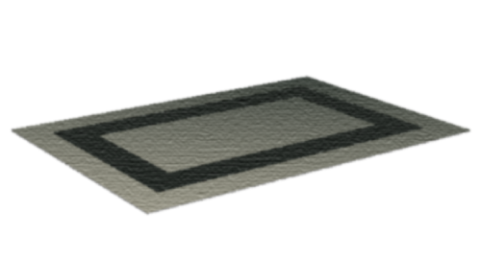
Carpet
- Freeze-spray
on new gum
- Liquid dissolver
on old gum
Spot Clean
Vacuum
Use machine spotting on larger spots.
The difference between a spill and a stain is time. Remove spots daily.
Vacuum carpeting, avoiding any previously
spotted areas that remain damp.
Notes:
Spot clean carpet. Use a freezing aerosol gum remover to remove fresh gum. Use a liquid gum dissolver to remove older gum.
On smaller spots (3” across or less) apply carpet spot remover to spills and other carpet spots until the surface is damp, not wet. Fold a clean, dry cloth into an 8-sided cloth, place over the spot, place a heavy weight on the cloth and go do something else for 20 to 30 minutes. When you return, remove the weight, turn the cloth over to a dry side, and step on the pad with your toe once or twice. This will remove 95% of all fresh spills and spots.
Use machine-spotting techniques to remove larger spots.
Vacuum carpeting, avoiding any previously spotted areas that remain damp.

Slide 14
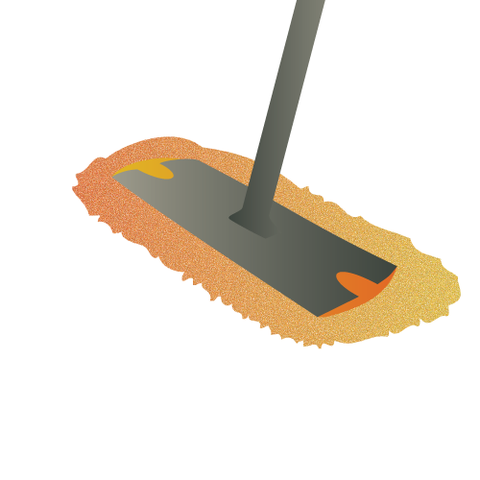
Dust Mop
Dust mop floor
Previously treated or microfiber dust mop
Clean under furniture and along edges.
Work from the corners outward; don’t pack soil into the corners.
Use a scraper, if necessary, to move soil out of the corner to where the dust mop can pick it up.
Notes:
Dust mop floor. Use a previously treated or microfiber dust mop to remove dust and debris from the area. Dust mop under furniture and along the edges of the room, paying particular attention to the corners, working from the inside of the corner outward to move soil away from, not into the corner. Dust mopping into the corner can pack the soil into the corner and create a “rounded” corner. Use a putty knife if necessary to remove soil and move it out where the dust mop can pick it up.

Slide 15
Damp Mop
Damp mop floor
Use a standard damp mop and bucket
or
microfiber damp mopping pads
Place floor signs appropriately
to prevent accidents.
Mop from the farthest corner towards the door. Rinse mop or change pads as necessary.
Leave signs in place until floor has dried.
Notes:
Damp mop floor. Place “Wet Floor” signs appropriately. Using a standard damp mop and mop bucket, or microfiber damp mopping pads, begin mopping at the far corner finishing at the door. Rinse mop or change pads as needed. Leave signs in place until floor has dried.

Slide 16
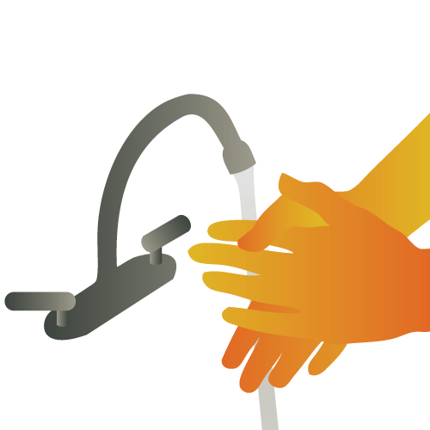
Think Safe—Be Safe
Think safety
Work safely
Wash your hands frequently
Wear appropriate PPE.
Use common sense:
Don’t mash trash with your hands
Always use Personal Protective Equipment to protect yourself from illness and injury.
Notes:
Don’t forget to wear the appropriate personal protective equipment and to practice common precautions, such as not compacting trash with your hands.
Think safety, work safely, and wash your hands frequently.

Slide 17
Thank you for using Hillyard Power Modules
Resident Room Cleaning
Living Quarters
© Hillyard, Inc.
Notes:
Thank you for using Hillyard Power Modules

